Slide 1



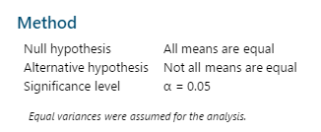

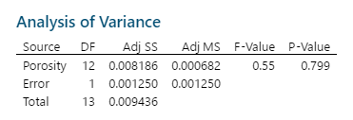
POSTER PRESENTATION ON MINITAB USAGE
ABOUT MINITAB???
Minitab is a command and menu driven software package for statistical analysis
USAGE OF MINITAB
Here Minitab is used for various statistical data analysis. From Histogram to ANOVA including Boxplot, Pie and Pareto chart, Bubble Plot, Scatterplot etc all of these are plotted here by means of MINITAB.
Cause and effect diagram
Histogram
Scatterplot
Missing button 50 0.17 36.89
Loose thread 21 0.89 59.63
Misaligned fabric 18 5.12 92.16
Fabric flaws 23 4.89 112.47
Stitching errors 112 1.89 211.68
Hemming errors 43 4.23 181.89
Hydrogen Porosity Strength
0.180000 0.500150 0.83931
0.210000 0.410000 1.12253
0.210000 0.450000 1.11309
0.210000 0.550000 1.10000
0.220000 0.440000 0.70705
0.220000 0.240000 0.49751
0.230000 0.470000 0.53000
0.230000 0.700000 0.52062
0.240000 0.800000 0.19287
0.240000 0.220000 0.54000
0.250000 0.880000 0.39086
0.260000 0.720000 0.42000
0.270000 0.750000 0.18348
0.280000 0.700000 0.24000
Bubble Plot
Pie Chart
Boxplot
Contact
Mumtahina Mansur
Roll:201636050
Level: 03
Department of Industrial and Production
Military Institute of Science and Technology
Pareto Chart
ANOVA
Probability Plot

